Slide 1
Overview of the WorkSafeBC Return-to-Work Planning Tool
Presentation to the BC Workers’ Compensation Advocacy Group
Tom McKenna CUPE National Health and Safety Representative & WCB Advocacy
November 04, 2025
Please see the accompanying document:
Return to Work Tool - WorkSafeBC - BC Federation of Labour WCAG presentation - Information Document to accompany PPT - 2025_11_04

Slide 2

Table of Contents
I. WHAT IS THE WORKSAFEBC RETURN-TO-WORK PLANNING TOOL
II. USING THE WORKSAFEBC RETURN TO WORK PLANNING TOOL
III. PROBLEMS AND ISSUES
IV. UNADDRESSED ISSUES AND PROBLEMS ASSOCIATED WITH BILL 41
V. IMPLICATIONS OF THE RETURN-TO-WORK PLANNING TOOL FOR UNIONS AND WORKERS
VI. POSSIBLE OPPORTUNITIES FOR UNIONS
VII. RECOMMENDATIONS FOR CHANGES TO THE RETURN-TO-WORK PLANNING TOOL

Slide 3

I. WHAT IS THE WORKSAFEBC RETURN-TO-WORK PLANNING TOOL
Online, voluntary, return-to-work planning tool that began in 2025 to augment law and policy.
Used to assist workers and employers in the return-to-work process, upload documents, modify return-to-work offers, and show that both parties are cooperating in the process.
It does not replace law and policy e.g. Section 154 of the Workers Compensation Act.
It is a tool and not the process to be used to comply with law and policy.
It is claim number specific and be used for multiple claims simultaneously.
The tool is meant for non-complex and non serious claims and may be difficult to navigate for inexperienced claimants and employers.
This presentation does not address the proposed new legislation allowing for 27 weeks of unpaid leave in a 12 month period for long term serious medical conditions, catastrophic illnesses or injuries etc.

Slide 4
II. USING THE WORKSAFEBC RETURN TO WORK PLANNING TOOL
Workers must have both a claim number and have an online account to use the new tool.
Employers must have a return-to-work plan in the online system to use the new tool.
Will be difficult for workers with uncertain diagnoses or conditions.
Will be difficult for workers with changing limitations and capabilities / abilities.
May be difficult for workers with ESL or literacy issues.
This tool is not easy to use for workers or smaller employers unfamiliar with WorkSafeBC claims.

Slide 5
III. PROBLEMS AND ISSUES
The worker is expected to self-identify their capabilities, not the medical practitioner.
Medical information - such as nature of the condition or limitations – is not considered.
The presence of ongoing symptoms is expected and is not a rationale for refusing to cooperate.
There is inconsistent direction for complex claims such as psychological injuries.
It does not sufficiently include references to duty to accommodate under human rights.
Will the contents of the tool be part of a Disclosure file in an appeal?

Slide 6






IV. UNADDRESSED ISSUES AND PROBLEMS ASSOCIATED WITH BILL 41
Remember Slide 3? There are many other problems and issues to be aware of:
Delayed or no diagnosis and treatment. Changing diagnoses, limitations, restrictions, and capabilities. Employers are increasingly referring workers to Independent Medical Exams. Restrictions that turn into limitations. Chronic conditions. Intermittent disabilities. Psychological injuries. Literacy and numeracy issues. How is “suitable” defined? Outdated Job Descriptions and Job Duties lists. Injuries arising from return-to-work programs. New related or unrelated claim decisions, etc. What is the role of Prevention Services in returning workers where there are unaddressed hazards that gave rise to the claim? Risk Assessments not conducted or that did not identify all hazards and barriers to return to work. Timing of the return-to-work e.g. before a vacation. What occurs in claim Reopenings? How is privacy managed e.g. diagnoses? How does this impact non-culpable discharge?

Slide 7
V. IMPLICATIONS OF THE RETURN-TO-WORK PLANNING TOOL FOR UNIONS AND WORKERS
It may confuse return to work and accommodation – especially human rights obligations.
May be used to reduce or remove the role of the Union in return to work and accommodation.
It may deviate from the the law on human rights obligations.
There may be privacy related issues e.g. if multiple people have access to the tool.
It may contradict Collective Agreement language or allow employers to deviate from the Collective Agreement.
It may contradict medical practitioner recommendations e.g. capabilities, limitations, etc.
It may increase the risk of reinjury, delayed recovery, and new claims.

Slide 8
VI. POSSIBLE OPPORTUNITIES FOR UNIONS
To educate and mobilize JHSCs on how the return-to-work process works.
To educate and mobilize JHSCs on hazard identification and rectification.
To compel employers to update Job Descriptions.
Early identification of employer return to work program and accommodation deficiencies.
Early identification of unadjudicated diagnoses and conditions (and sequelae).
Early warning system for claims suppression and Prohibited Action Complaints.
To determine of the employer has done related Incident Investigations / Form 52E40.

Slide 9
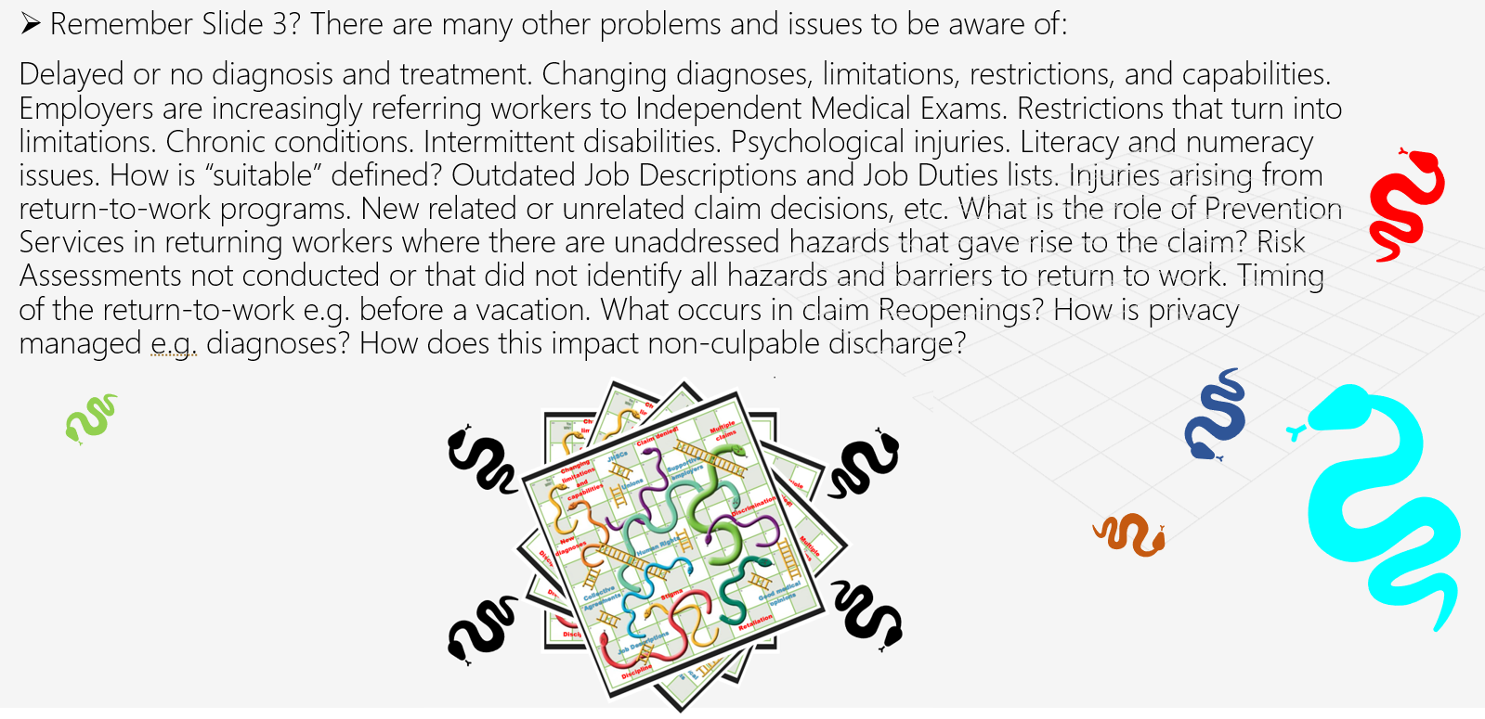
VII. RECOMMENDATIONS FOR CHANGES TO THE RETURN-TO-WORK PLANNING TOOL
Include more links to relevant law and policy.
Include “key legislation and RSCM II Policy” boxes to notify the employer of key requirements.
More uniform language regarding return to work and accommodation.
Include a new section that flags other issues and problems that may arise per Slide 6.

Slide 10
Questions?
Tom McKenna contact information: tmckenna@cupe.ca
Need more information?
WorkSafeBC: Create return-to-work plans with ease: Coming soon - WorkSafeBC
Notes:
It is important to reiterate that there should be extreme caution in complex claims, claims for psychological conditions, overlapping claims, extended duration claims, etc. The tool should not be a replacement for the human rights duty to accommodate obligations.

