Slide 1
FATAL CLAIMS:
EVERY LIFE HAS VALUE
FEBRUARY 14, 2026 LUNCH & LEARN SERIES

Slide 2

A Lesson on How the BC Compensation Values Life
Logging operation Haida Gwaii early 1990’s
18-year-old equipment-yard helper sent out to logging road building to drive Moxie Truck

Slide 3
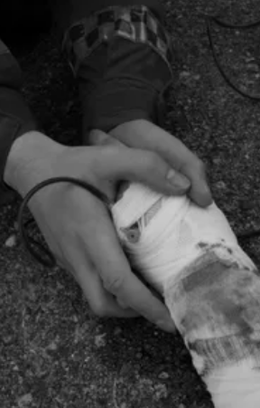
A Lesson on How the
BC Compensation Values Life
Operator not available – yard helper has only moved Moxies in the yard
No training, put onto steep logging roads with loads
Brakes fail from overload
18-year-old dies in crash
Employer penalized cost of claim less than $8,000

Slide 4

Discount for Death
No dependents
Funeral costs only
Family devastated
Years of life and potential lifetime earnings lost

Slide 5

RPN 2025
RPN assaulted 2021 – physical and psychological injury
PPD for PTSD
Assaulted again 2025 – physical and psychological injury
Feels unsupported – completes suicide
No dependents – funeral benefits only ~$11,456.68
PPD savings >$196,309.80

Slide 6
BOGYO Options
December 2018
Fatal benefits at Board Max
Benefit to estate on death of a worker
Proposed 50% of 12 months max

Slide 7
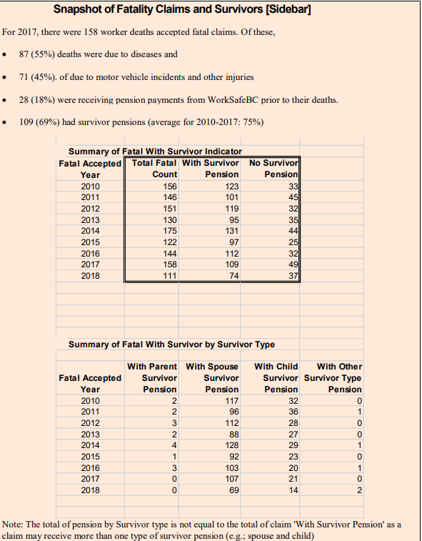
Snapshot of Fatality Claims and Survivors [Sidebar]

Slide 8
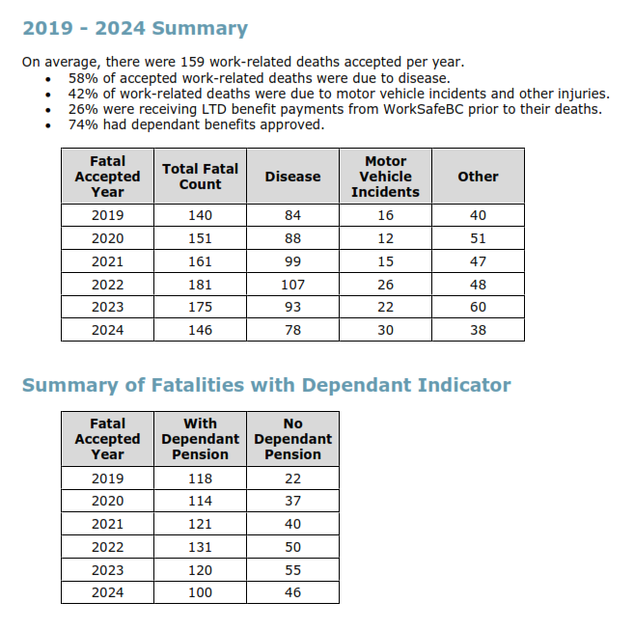
2019 – 2024 Summary

Slide 9
Propose 12 Months of Board Max to Estate on All Fatal Claims
2026 Board max $127,500
Average work-related deaths per year 159
159 x 127,500 = $20,272,500
Claims costs 2024 $1,453,983,000
Fatal benefit would be ~1.4% of claim costs
Less replacement of funeral costs

Slide 10
(7) Benefit to Estate on the
Death of a Worker
[50% 12 months of Max Benefit]
Accident Fund ($ million)
Funding Model (per $100.00
Assessable Payroll)
One-time Liability Impact
Annual Cost
Rate Impact Amortized over 5 Years
Rate Impact for All Years
$0.006 $0.006 $0.006 $0.006 $0.006
$0.008
Figure 25 – Impact of Option 7: Benefit to Estate on Death of a Worker

Slide 11
Penalties for Fatalities
General purpose of penalties is to “motivate compliance with the Act”
Investigation of fatalities takes years
Criminal Negligence – Caron death 2012 conviction 2025
The system does not deter or prevent
Penalties do not compensate the victims
Adam Smith’s “Invisible Hand”

Slide 12

Jurisdictional Comparison
Almost every other Canadian jurisdiction provides lump sum benefits for fatalities
E.g., Ontario $103,023.22 to spouse +/- $2,575.57 for each year under or over 40
Alberta lump sums $2,652.38 + $19,800.00 + bereavement counselling + transportation in any reasonable amount
https://awcbc.org/files/benchmark-tables/Dependency-Benefits-and-Fatalities-En.pdf
Societal change on spouses and dependents much like retirement age

Slide 13
Justice for Fatally Injured Workers
Penalties don’t work
Stop the discount for death
Dependent benefits are for wage loss only
Legislative change to BC Workers Compensation Act required
Replace s. 166 funeral expenses with estate lump sum
s. 167 lump sum to spouse or foster parent

