Slide 1
Claim suppression in BC
Presentation to BC Fed OH&S Committee
    Paul Petrie June 10, 2025
Notes:
Thanks to Megan, Sheila and Janet

Slide 2
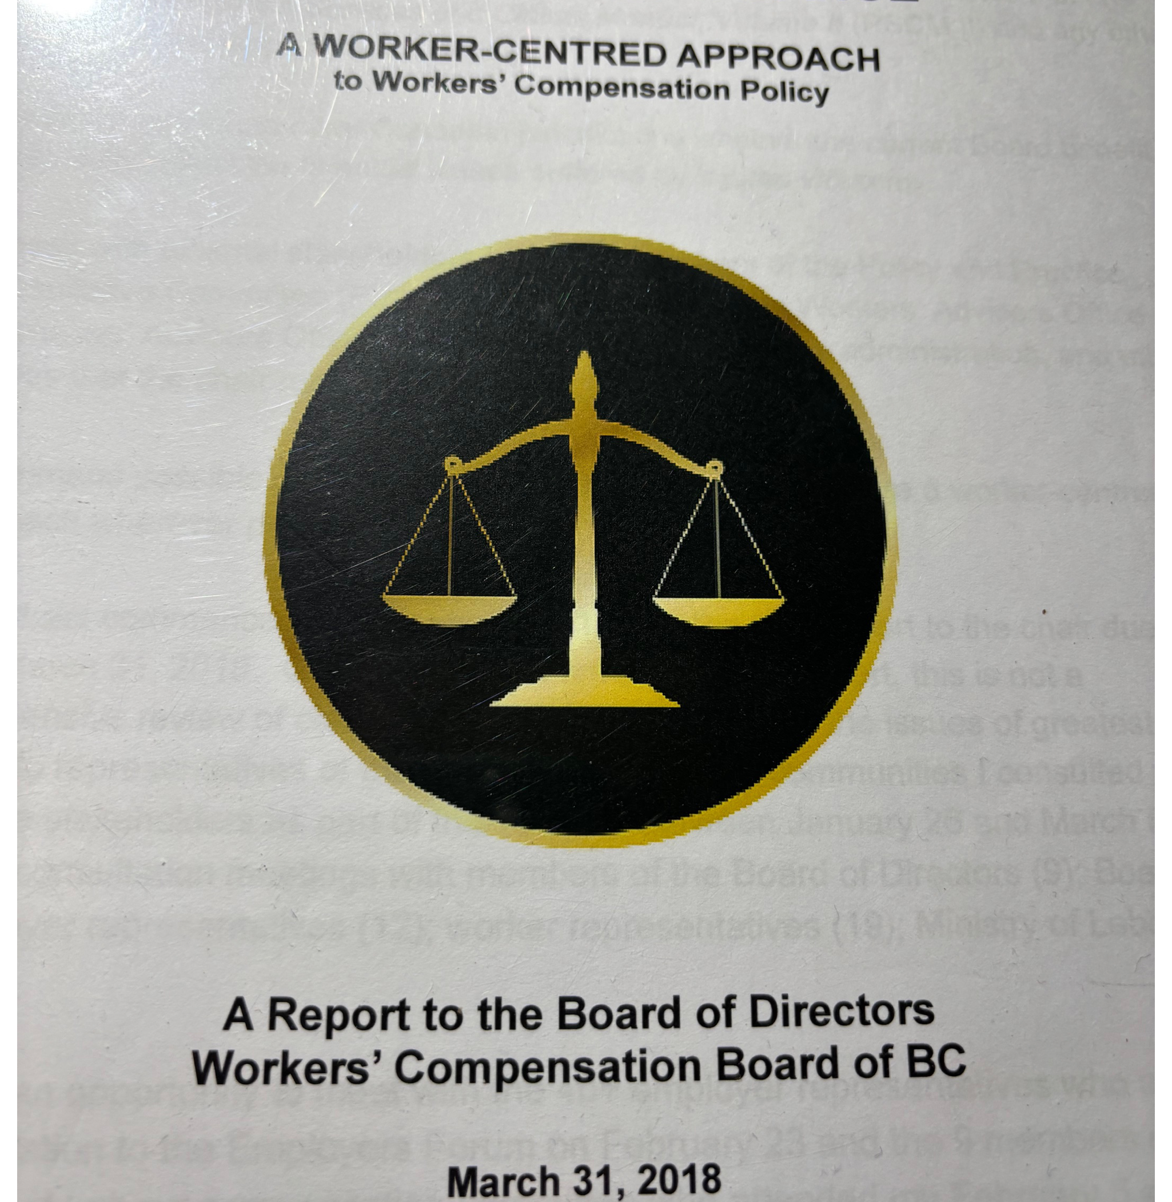
Restoring the Balance
2018 claim policy review
34 recommendations
#21 Commission an independent review of the nature and extent of claim suppression in BC
Notes:
Minister Bains
Fed OH& S Committee
Nina Hansen
Tom McKenna
Merrill
Lynn Bueckert

Slide 3
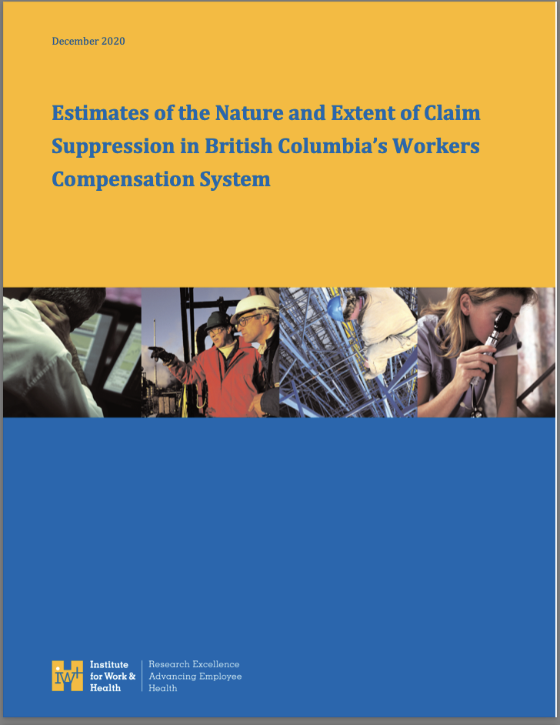
Institute for Work & Health
Claim Suppression Study
December 2020
Notes:
Important document
comprehensive 125pp
Alot of table a lot of statistics
Not directly involved FN WSANEC
Tom McKenna summary
2 key findings

Slide 4
IW&H Claim Suppression Study
Key findings
Almost half of all workplace injuries in BC go unreported by employers, contrary to the legal requirements in the Act
Illegal claim suppression activities by employers are present between 3.7% and 13% of all workplace injuries.
Notes:
I knew it was bad, but this surprised me
Claim suppression out of sight -- illegal
a very conservative estimate
OK< what is the Board doing about this.
nothing on Boards website about report - strange
Contacted Policy depart - sent to legal
Un helpful - FOI

Slide 5
WorkSafe BC enforcement
A 2021 FOI request documents a lack of enforcement for an employer’s failure to report work injuries and claim suppression activities by employers. For example:
Of the estimated 45,000 unreported work injuries in 2019, there was only one (1) investigation under section 150 of the Act and no penalties.
Of the estimated 3,000 work injuries involving claim suppression activities by the employer in 2019, there was only 1 penalty ($15,500) under section 73 of the Act
Notes:
45,000 best conservative estimate
2019 alone!
And only 1 investigation s. 150
Unbelievable!
3,000 is a guestimate very hard to tease out of the data
Only 1 penalty !!! WOW
I needed to report out to the BoD & Minister Bains so...

Slide 6
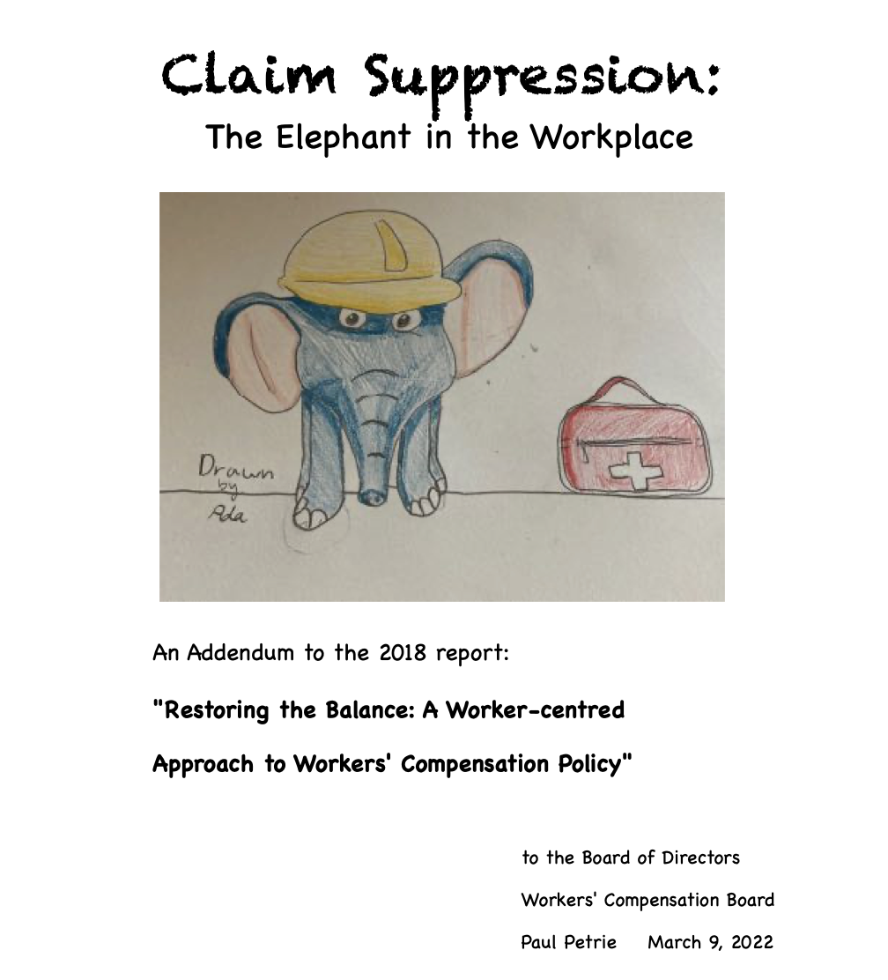
Notes:
Please appreciate the art by my then 10 year old granddaughter Ada
She lives in LA and we had weekly facetimes where she was giving me drawing lessons
as a budding artist, she was delighted to get her art "out there"

Slide 7
The Elephant in the workplace
Summarizes 125 page IW&H Claim Suppression Study
Lists 28 key findings from the Claim Suppression Study
Estimates 45,000 unreported work injuries in 2019 alone
Results in $50 million in economic costs to injured workers, their families and BC taxpayers in 2019
Notes:
Distilled the data into 28 key findings from the report
provided the detailed calculations for the "conservative estimate of 45,000
Used WCB annual report data to conservatively estimate the economic costs
of course, the human and social costs would be impossible to calculate,

Slide 8
The Elephant in the Workplace
13 recommendations for the WCB Board of Directors
Posting information bulletin in every workplace about workers’ rights to compensation and employers’ responsibilities under the Act.
Initiating a claim suppression education program as recommended by Janet Patterson in her New Directions Report.
Developing a claim suppression audit to identify violations and promote corrective action
Develop a dedicated claim suppression unit to ensure compliance with the Act
Notes:
Based on the 28 key findings I made 13 recommendations for the Boards administration
These 4 were "low hanging fruit"
easy to implement and not expensive
But the most important piece in the elephant was a discussion of experience rating - the method adopted by the Board in 2,000 to calculate employer assessments

Slide 9
Under the BC experience rating system, the employer’s assessment rate can range from:
a maximum assessment (surcharge) of 100% of the base rate with very high claim costs over the prior three years,
to a minimum assessment (discount) of 50% with very low claim costs.
Notes:
Formula is complex, but the concept is simple.
The claim cost for the employer's injured workers are totaled over a 3 year rolling average and if the employers claim costs are higher than the industry average, they receive a surcharge up to 100 % above the industry base rate for a very high claim cost average
for an employer who has lower than average claim costs, they receive a discounted rate
It doesn't take a genius to figure out that one way to save money was to not report a work injury

Slide 10
The impact of experience rating
        Independent research shows that experience rating:
Provides a financial incentive for employers who do not report report work injuries
Promotes a significant level of illegal claim suppression
Encourages premature return to work before the worker can safely perform their work duties
Provides a financial incentive for employers to dispute legitimate claims
Notes:
claim suppression
Benefit suppression - keep the costs down by any means available
Fuels an adversarial system, making the decision making process for some workers Toxic.

Slide 11
The impact of experience rating con’t
Employers who cheat the system gain a competitive advantage over employers who meet their reporting requirements
Public sector employers and unionized employers are more likely to comply with reporting requirements
Notes:
ER Also raises an issue of employer equity

Slide 12
The consequences of experience rating:
Injured workers and their families bear the economic and social costs of unreported injuries
Taxpayers pick up some of the unfunded costs from claim suppression (e.g MSA, etc.)
Unions face increasing costs to represent their members in the adversarial system

Slide 13
The adversarial nature of experience rating has a negative impact on injured workers.
Recent research shows that:
“… experiencing rating stimulates employer behaviours which can undermine the the physical and mental health of injured workers.” Mansfield et. al. 2012
Notes:
The toxic adversarial system also takes it toll on the workers mental
and can delay recovery

Slide 14
Does experience rating stimulate safer workplaces?
Research by Mansfield shows that experience rating:
“…has not achieved that safety effect, and that in some cases it has contributed to unsafe workplaces.”
Notes:
This is the key question!
Compensation system under ER has a claim cost focus - prevent claim costs by any means available, shifts the focus away from real prevention that focuses on controlling the hazards that cause the injuries in the first place
NOT on controlling the claim costs after the injury occurs.
WSBC continues to cling to this myth.

Slide 15
In my 2022 addendum I recommended that the WCB:
initiate an independent review of Experience Rating
Fund the 1st 2 weeks of claim costs collectively
Implement Janet Patterson’s recommendation #51 to establish best practices for returning injured workers to safe, productive and sustainable employment
Notes:
ER impact on injured workers and compensation entitle
an attempt to bring "collective liability" into the picture. a small, but very doable step.
Take the heat off the frenzy to get workers back to lunch-room jobs, or lite duty jobs that are not light and can harm recovery
Janet's Rx would control this frenzy and restore injured workers to suitable, safe and sustainable re employment

Slide 16
Did the WCB implement any of these recommendations?
No of course they didn’t
Instead, in response to pressure from the employer lobby,
The Ministry and the Board enacted the “Duty to Cooperate”
To help enforce employer claim cost strategies.
Notes:
Many of you will have seen Rolf Harrison's insightful blog in April illustrating the the toxic impact of the "duty to cooperate". The story of BOB who was relentlessly harassed by his employer to get back to work against his doctor's advice . A decision on his claim was delayed as a result.
One union rep referred this to a catch and release maneuver where the worker is induced to come back to work too soon and when things don't work out they are "let go".

Slide 17
“Weaponizing Return to Work”
  “In a sane compensation system, employer misconduct like this would be a heavily penalized offence. Instead, our system both turns a blind eye to the misconduct and rewards it. The job before us is to force our provincial government and WorkSafeBC to stop this practice dead in its tracks.” Rolf Harrison
Notes:
I will have more to say about the importance of illustrating this abuse of compensation entitlement with individual worker's stories.

Slide 18
Four years after the IW&H Claim Suppression Study what has WorkSafe BC administration done about the extensive under reporting and claim suppression?
In 2024 WSBC established a small claim suppression unit
That unit completed 14 investigations of claim suppression
activities resulting in four (4) penalties averaging $6,700 each
In 2024 there were 20,264 claims adjudicated without an employer’s report of injury.
WorkSafeBC conducted 0 investigations and no enforcement of this blatant non-compliance with s. 150 of the Act.
Notes:
a slap on the wrist and a drop in the bucket solution
The board admits to adjudicating 20,000 claims without an employer's report of injury, but to use Rolf's observation "turns a blind eye" to this violation of the employer's statutory duty.

Slide 19
Given the lack of enforcement in response to the extensive under reporting of work injuries and significant level of claim suppression resulting from the corrosive policy of experience rating, I concluded in my 2025 addendum:
“WorkSafeBC has pursued a path through experience rating that undermines the very integrity of BC’s workers compensation system.”
Notes:
OK, time to do a second addendum. in which I documented the lack of effective enforcement for employers who cheat the system
The primary purpose of the Act is to provide injured workers with full and fair compensation.
ER undermines the purpose of the act an turns it into a toxic adversarial insurance scheme rather than an due compensation entitle under an inquiry systementitlement system

Slide 20
Based on this finding I recommended:
That the WCB Board of Directors initiate the steps necessary to transition from the current experience rating system to a collective liability focused funding mechanism in consultation with representatives from the worker and employer communities and with injured workers.
I also recommended that the BoD review Yukon’s modified collective liability system that places the priority on prevention of injuries rather than controlling the claim costs after the injury has occurred.
Notes:
Before I WRAP UP, JUST A QUICK WORD ABOUT illustrating the abuse of worker entitlement by telling injured worker's stories as Rolf did in "Weaponizing RTW."
We need more of that.
Manitoba experience
My retirement!

Slide 21
        Thank you!
        Questions?
        Comments

Slide 22
Comparison of collective liability and
experience rating systems
Collective Liability System | Experience Rating System
• Employer assessments are based on industry average of claim costs. | • Employer assessments* are based on individual employer claim costs.
• Each employer in the industry pays the same rate per $100 of payroll. | • Each employer pays a different rate, depending on their claim costs.
• Incentive is on prevention initiatives at the industry level. | • Incentive is on controlling claim costs at the individual claim level.
• focus is on safe, productive, and sustainable employment. | • focus is on return to light duties ASAP to minimize time loss.

