Slide 1
2025 ASTD Policy Amendments and
Updated Practice Directive

Slide 2
Application
Draft amendments proposed by PRRD in 2024
Stakeholder feedback on the draft proposal in 2024
Board approved in a Resolution on April 25, 2025
Applies to all decisions, including appellate decisions, made on or after July 14, 2025.

Slide 3
Reason for Amendments
To complete the workplan item
Ostensibly to reflect recommendations #36 and #37 of Restoring the Balance, a policy review by Paul Petrie, and recommendations in New Directions, the comprehensive review by Janet Patterson
Notes:
Petrie #36- require relevant prevention-related risk factor analysis data from the workplace under the OHSR requirements and guidelines be considered in the adjudication of ASTD claims for compensation.
#37 - WorkSafeBC consider developing an ASTD policy specific to the risk factors reflected in the MSI Requirements and related guidelines from workers with intense typing, keyboarding and mousing tasks are often denied because WorkSafeBC considers a single risk factor, like repetition, cannot result in an injury. Yet this is inconsistent with how WorkSafeBC addresses MSI issues for computer use under the OHSR and guidelines.
New Directions
The report notes stakeholders raised concerns about ASTD policy and practice, including that women are at greater risk for ASTD-type injuries because employment risk factors for women are different and have lower thresholds. Applying non-gendered risk factors that do not account for gender differences creates a bias against women.
The report also recommends WorkSafeBC develop policy and practice to integrate its prevention and compensation approaches.

Slide 4
What informed the amendments?
No consultation prior to draft
WCB commissioned a literature review
Literature revealed a wide variety of study types and methodology
Literature review found insufficient evidence to establish a strong causality between occupational risk factors and various ASTDs
Literature did not indicate that there is not causality
Literature supported identified gender bias against female claimants

Slide 5
Focus of Changes:
Clarify that if the Schedule 1 requirements for the presumption of work-relatedness are not met, claim must be determined on a case-by-case basis under ASTD policy
Reiterate the proper test for causation
Clarify a single factor can be enough
Reiterate that a worker’s personal characteristics must be considered
Consistency in language between S.136 and S.134

Slide 6
Establishing Work Causation for
ASTDs of the Limbs ITEM: C4-27.10
A. ESTABLISHING WORK CAUSATION
The method by which an ASTD is designated or recognized by the Board as an occupational disease affects how the Board determines work causation.
the Board determines whether a worker’s employment was of causative significance in causing or aggravating the worker’s ASTD based on the circumstances of the individual case, with consideration of risk factors set out in policy, and the current medical/scientific evidence was caused or aggravated by the worker’s employment (see Item C4-25.20).

Slide 7
Causative significance means more than a trivial or insignificant aspect. The employment (the employment-related exposure to risk factors) need not be the sole or even the predominant cause; the employment only needs to have been of causative significance.
Evidence that the worker’s ASTD has been accelerated, activated or advanced more quickly than would have occurred in the absence of the employment, may be confirmation that their employment was of causative significance in aggravating the ASTD.
The Board recognizes that…some people are more susceptible to the development of ASTDs than others. This is not a bar to compensation. The worker’s employment will have been of causative significance if the employment-related exposure to risk factors was more than a trivial or insignificant aspect in causing or aggravating the ASTD;

Slide 8
ASTDs are often caused by exposure to a combination of risk factors, rather than just one risk factor. However, for some ASTDs and under certain conditions, a single risk factor may be of causative significance if the exposure to that risk factor is of a particularly high degree of intensity, magnitude or duration.
B. ANALYZING RISK FACTORS
Both employment-related exposure to risk factors and non-employment-related exposure to risk factors may contribute to the ASTD. Work causation is proved if it is “at least as likely as not” the worker’s employment was of causative significance in causing or aggravating the worker’s ASTD.
taking into consideration the worker’s individual characteristics.
Notes:
Seconf paragraph- not in the draft policy we received, but similar language to a section removed in the next policy item

Slide 9
ASTDs Recognized by Inclusion in Schedule 1 RSCM#C4-27.20
If the worker was not employed in the process or industry in Schedule 1 for the specified ASTD (i.e., the descriptions in column 2 opposite to the ASTD are not met), the presumption does not apply. The Board then determines compensability in accordance with Item C4-27.10 on a case-by-case basis (see Section E., below).
The compensability of a claim for an ASTD listed in Schedule 1 where the presumption does not apply depends on whether or not the employment activities (the employment related exposure to risk factors) played a significant role in producing the ASTD. The employment-related exposure need not be the sole or even the predominant cause; it simply needs to have been of causative significance.
Notes:
This is the struck out section that has similar wording to the addition on the prior slide-

Slide 10
ii. Significant Flexion, Extension, Ulnar Deviation or Radial Deviation
In item 14(1) of Schedule 1, the words “significant flexion, extension, ulnar deviation or radial deviation of the affected hand or wrist” generally mean:
moving (or holding) the hand or wrist in greater than 2545 degrees of extension from functional anatomical neutral (200 degrees from anatomical neutral);
ii. Sustained Abduction or Flexion of the Shoulder Joint in items 13(2) and 14(2) of Schedule 1, the words “sustained abduction or flexion of the shoulder joint” mean that the shoulder joint is held in a static position of abduction or flexion greater than 60º. Generally, the greatest pressure is placed on the shoulder bursa when there is between 60º and 120º of abduction or flexion (0º being when the arm is straight down by the side of the torso).
Notes:
This change indicates the numbers provided in policy should be interpreted in a flexible manner, and is consistent with similar decision-maker discretion in the policy’s guidance of other Schedule 1 terms and phrases. The word “generally” provides decisionmakers with discretion to consider the particular circumstances and exercise judgment according to the merits and justice of the case.56

Slide 11
Establishing Work Causation ITEM: C4-25.20
ii. Aggravation of a Disease
Evidence that the pre-existing disease has been significantly accelerated, activated, or advanced more quickly than would have occurred in the absence of the work activity, may be is confirmation that the aggravation resulted from the employment activity a compensable aggravation has resulted from the work.
The language about work activities drawing a pre-existing condition to the worker’s attention have been deleted.

Slide 12
Respiratory Diseases ITEM: C4-29.00
ii. Pre-Existing Asthma Condition
A pre-existing asthma condition is not compensable unless such underlying condition it has been significantly aggravated by an occupational exposure (i.e. accelerated,activated, or accelerated advanced more quickly than would have occurred in the absence ofby an occupational exposure).

Slide 13
Other Matters ITEM: C4-32.00
2. Pre-existing Contact Dermatitis Condition
A pre-existing contact dermatitis condition is not compensable unless such underlying conditionit has been significantly aggravated by an occupational exposure (i.e. accelerated, activated, or accelerated advanced more quickly than would have occurred in the absence ofby an occupational exposure).
Notes:
The proposed policy amendments would enhance awareness of and reinforce the correct approach to determining work causation for ASTDs and what causative significance means. This would increase consistency in decision-making and may lead to an increase in the number of claims accepted for ASTDs, which would increase related costs.

Slide 14
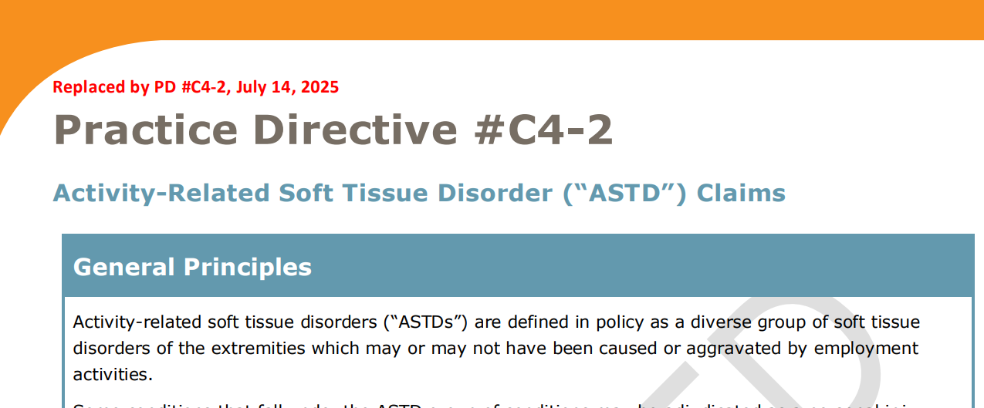
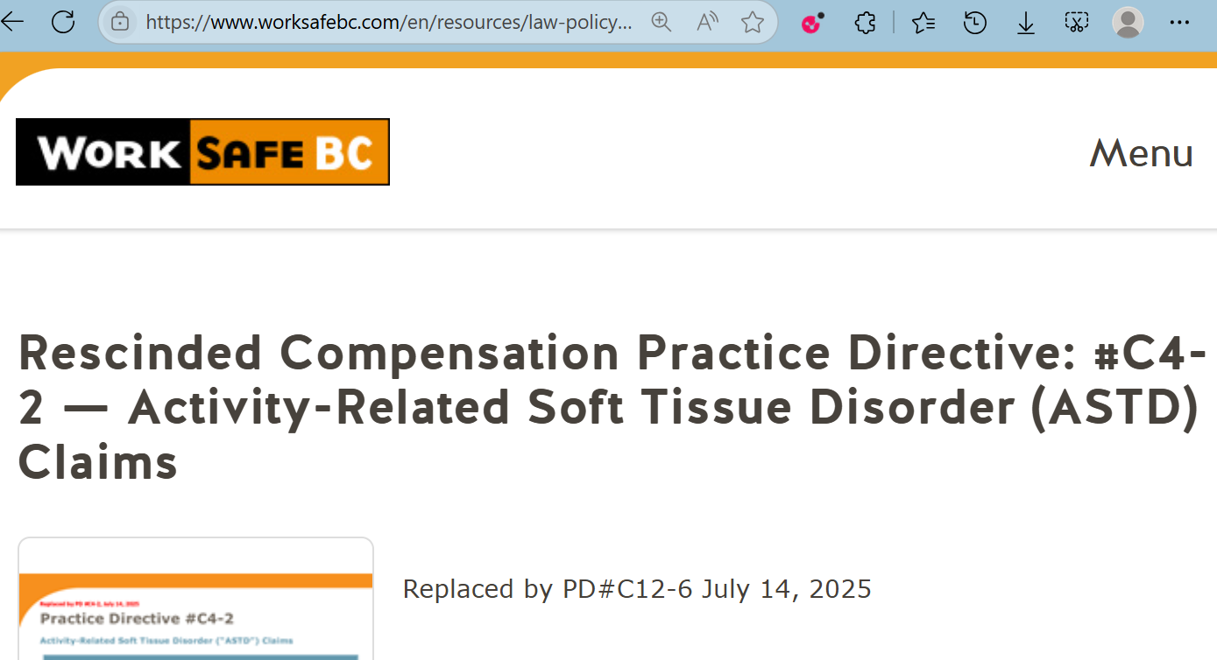
Where is the Practice Directive?
Notes:
What you may find online- not yet properly posted.

Slide 15
Amended Practice Directive #C4-2
First change is under “Adjudicative Test- Causation” (p.3)
The method by which an ASTD is designated or recognized by WorkSafeBC as an occupational disease affects how WorkSafeBC determines work causation. An ASTD included in Schedule 1 has the benefit of the rebuttable presumption of work causation provided for in section 137 of the Act.
There is no rebuttable presumption for ASTDs recognized by regulation of general application or by order in a specific case. In these cases, when considering causation, the WorkSafeBC officer needs to determine on a case-by-case basis whether the worker's employment was of "causative significance" in the occurrence of the injury or disease. Policy defines causative significance as meaning the work activities were more than a trivial or insignificant aspect of the injury or disease.
Notes:
Slide 15- these paragraphs are additions. They emphasize that if the claim does not meet all the criteria for schedule 1 rebuttable presumption, there is no presumption. Reiterating no presumption for ASTDs recognized by regulation.

Slide 16
ASTDs are complex and often involve multiple contributing factors. As a result, a thorough analysis is required to determine whether the ASTD was caused by the work activity. For the ASTD to be compensable, the work activity must have contributed in a meaningful more than trivial way. The work injury need not be the only cause or the predominant cause of the worker's ASTD. Rather, the work activity must have been a significant contributing factor in order of causative significance for the ASTD to be compensable. As intended by the policy definition of causative significance, it is not enough for the work injury to have contributed in a minor fashion; it has to have contributed to a material degree in a more than trivial or insignificant way, and involve employment-related risk factors.
Notes:
Slide 16- replacing varied terms with more consistent language that reaffirms causative significance as the correct test

Slide 17
Evidence (PD C4-2, p.4)
In weighing the evidence, WorkSafeBC takes into account all of the relevant facts and circumstances relating to the case before it, including the worker's individual characteristics circumstances (i.e., how the ASTD risk factors may be influenced by the worker's individual characteristics).
Notes:
Slide 17- this is another addition – reiterating need to consider interaction of risk factors and individual characteristics

Slide 18
Aggravation of a Pre-Existing Condition (PD C4-2, p.4)
Item C4-25.20, Section C.ii. explains what is meant by an aggravation, which is to significantly accelerate, activate, or advance - evidence that the pre-existing disease has been accelerated, activated, or advanced more quickly than would have occurred in the absence of the work activity, the underlying/pre-existing condition may be confirmation that the aggravation resulted from the employment activity.
Notes:
Slide 18- amending language to reflect policy amendments and promote consistency between S.134 and S.136.
-also cut the example of carpal tunnel, and removed language about work “bringing symptoms to light”

Slide 19
Appendix (PD C4-2, p.10)
Updated to reflect 45 degrees from anatomical neutral language in Policy amendments

Slide 20
Final takeaways
No sweeping change or improvements- more incremental clarification.
Educate your Representatives.
Include the amendments in your argument and remind the adjudicator of the reasons for the amendments- they have been getting it wrong!
We are in early days- please share your experiences so we can learn.

